Slide 1
7nm SRAM using EUV Lithography for Peripheral repair analysis
Manny Xu CKT
201805

Slide 2
Background
1、7nm EUV Lithography 技术带来high defect
因此需要repair scheme
2、以往论文关注点主要是bitcell repair
本论文关注的是 peripheral logic repair

Slide 3
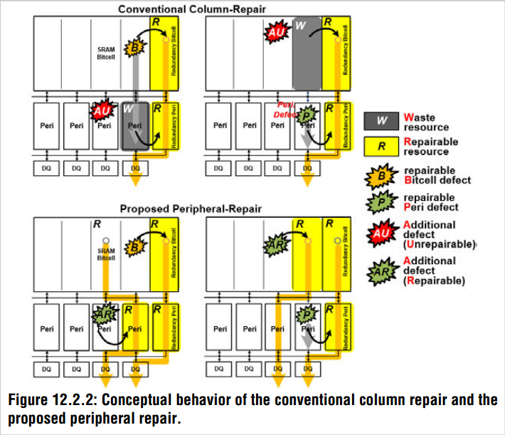
Repair behavior
传统是bitcell或者peripheral has defect, 整体替换
本文，bitcell peripheral 分开替换
Notes:
Functionality and high yield at low supply voltages such as 0.7V has become more difficult to achieve with the degradation of write margin and the optimization between read disturb and write margin

Slide 4
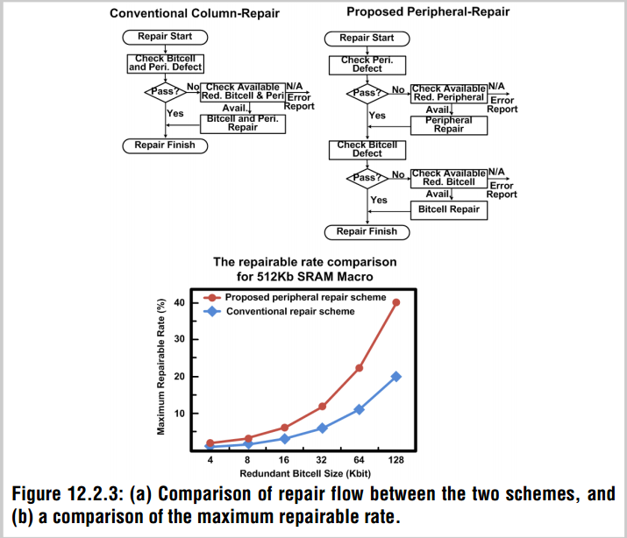
Repair desicion

Slide 5
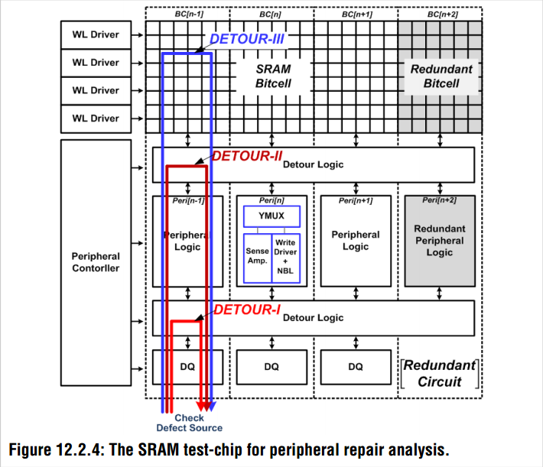
Peripheral repair analysis
Detour logic

Slide 6
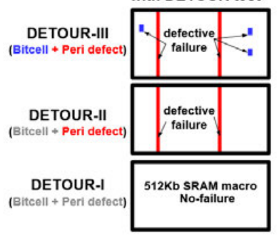
Detour logic

Slide 7
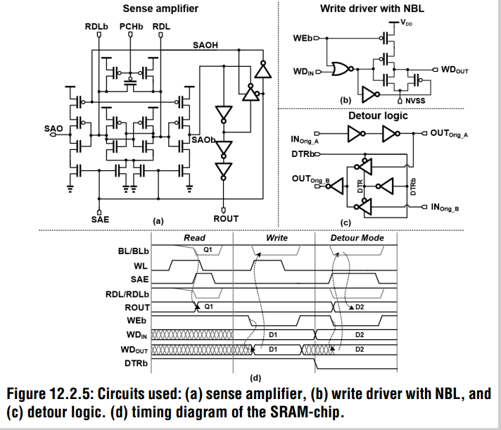
Circuits
When detour mode is enabled, the detour logic disconnects the INorig_B-OUTorig_B path and then configures IN orig_A-OUTorig_B path, which helps to validate the failure between the bitcell array and peripheral logic

Slide 8
summary
1、512kb sram with 16kb redundancy
2、6% repairable rate compare to 3% in convertional approach

Slide 9
Thank you

